Slide 1

A NOVEL COVERTER TOPOLOGY FOR STAND ALONE HYBRID PV/WIND/BATTERY POWER SYSTEM USING MATLAB /SIMULINK.
A MINI PROJECT
Submitted to
JAWAHARLAL NEHRU TECHNOLOGICAL UNIVERSITY HYDERABAD, TELANGANA
In partial fulfilment of the requirement for the award of the degree of
BACHELOR OF TECHNOLOGY
In
ELECTRICAL AND ELECTRONICS ENGINEERING
By
G.AKHIL (18C35A0212)
E.SAIRAM (18C35A0211)
N.ACHUTHANANDA (18C35A0229)
S.SRAVYA (17C31A0269)
under the esteemed guidance of
Mr.M.KARTHIK REDDY, Asst Professor
DEPARTMENT OF ELECTRICAL AND ELECTRONICS ENGINEERING
BALAJI INSTITUTE OF TECHNOLOGY AND SCIENCE
Accredited by NBA, NAAC & ISO 9001:2015 Certified institution
(Affiliated to JNTUH & Approved by AICTE, New Delhi)
NARSEMPET, WARANGAL-506331
(2020-2021)

Slide 2
CONTENTS
Abstract
Introduction
Wind electricity generation
Photo voltaic systems
DC-DC converter
Existing system
Proposed system and topology
Modes of Operation & simulation
The analysis for the three states based on battery utilization
conclusion

Slide 3
ABSRACT
The objective of this project is to propose a multi-input power converter for the hybrid system that interfaces two unidirectional ports for input power sources, a bidirectional port for a storage element, and a port for output load in a unified structure. The two input ports for simultaneously converting two different input power sources with low voltages to a stable output power with a high voltage. According to various situations, the operational states of the proposed converter can be divided into three states based on battery utilization .In order to ensure that the system operates with high efficiency, this project proposes a power management control scheme, which controls the bidirectional converter operating under boost mode according to the operation condition of the PV/Wind , so that the battery can be charged or discharged. The integration of the hybrid renewable power system is implemented and simulated using MATLAB/SIMULINK.

Slide 4
INTRODUCTION
The use of renewable energy sources as a promising path for replacement of fossil fuels and the development of Power Electronics systems for capitalizing such Energy sources have received renewed interest in the past decade. They can be utilized simultaneously to maintain continuous delivery of power to the load. Among available renewable energy technologies, Wind and Solar Energy are the most promising options.
In order to obtain a more consistent energy flow for the user demand, there has been a growing trend to combine the renewable energy sources with Diesel generators, Battery bank, Ultra-capacitors, a common short-term solution for energy storage is a Battery bank, which offers advantages of high efficiency and fast charge/discharge capacity. Recently, the use of a Multiple-Input Converter (MIC) which is capable of converting power from multiple power sources to a common load.

Slide 5
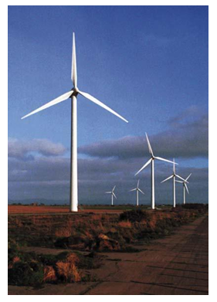
WIND ELECTRICITY GENERATION
The process of creating electricity using wind or air flows that occurs naturally in earth’s atmosphere.
Wind power technology dates back many centuries. Used in propel boat, water pumps, wind mills, new ways eventually spread all the world.
Wind energy is cost effective, Renewable & clean free energy source and can be built on existing ranches.
To a lesser degree, there has been a parallel development in small-scale wind generators for supplying electricity for battery charging, for stand-alone applications and for connection to small grids.

Slide 6
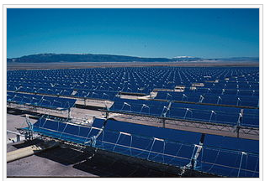
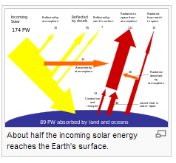
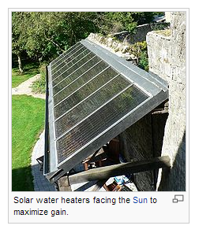
PHOTOVOLTAIC SYSTEMS
SOLAR ENERGY radiant. light and heat from the sun.
Solar technologies are broadly characterized as either passive solar or active solar depending on the way they capture, convert and distribute solar energy.
The Earth receives 174 petawatts (PW) of incoming solar radiation (insolation) at the upper atmosphere Approximately 30% is reflected back to space while the rest is absorbed by clouds, oceans and land masses. The spectrum of solar light at the Earth's surface is mostly spread across the visible and near-infrared ranges with a small part in the near-ultraviolet.
The total solar energy absorbed by Earth's atmosphere, oceans and land masses is approximately 3,850,000 hexajoules (EJ) per year
Photovoltaic systems also include water heating, cooling, and ventilation.

Slide 7
DC-DC CONVERTERS
An electronic circuit or elctromechnical device which converts a source of DC from one voltage level to another. It is a type of electric power converter.
Several methods exist to achieve DC-DC voltage conversion. Each of these meth-ods has its specific benefits and disadvantages, depending on a number of operating conditions and specifications
Linear Voltage Converters, Switching-mode DC/DC, Synchronous generators

Slide 8
EXISTING SYSTEM
Recently, the use of a Multiple-Input Converter (MIC)to replace several single-input converters for reducing complexity and cost of hybrid power systems has attracted increasing attention.
In past literature, a variety of power converter topologies and control methods was proposed to interface hybrid sources to different loads. In the traditional structure, Multi Input converters based on buck, boost, and buck–boost topologies have been reported.
The main limitation of these configurations is the lack of a bidirectional port to interface storage device. Multiport converters are also constructed out of a multi winding transformer based on half-bridge or full bridge topologies.
They can meet isolation requirement and also have bidirectional capabilities. However, the major problem is that they use too many active switches, in addition to the bulky transformer, which cannot justify the unique features of low component count and compact structure for the integrated multiport converter.

Slide 9
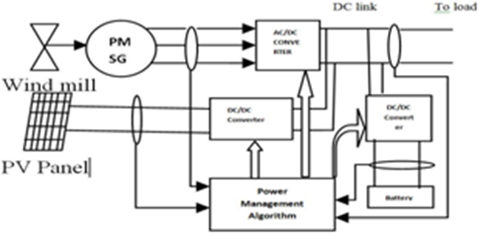
PROPOSED SYSTEM
This proposes a power management control scheme, which controls the bidirectional converter operating under boost mode according to the operation condition of the PV/Wind , so that the battery can be charged or discharged.The Photovoltaic generation with Wind power generation, the instability of an output characteristic each other was compensated.
The Input Power source1 is Photovoltaic (PV) cell, Power source2 is the Wind and the storage element is the Battery. Both Wind generators through AC/DC converter and Photovoltaic (PV) array is connected to DC/DC converter and common DC link. The feedback is taken from both power generator and also from common DC-link as an input to the power management algorithm block. The PV array and Wind turbine work together to satisfy the load demand. When energy sources (solar and wind energy) are abundant ,the generated power, after satisfying the load demand, will be supplied to feed the battery until it is fully charged.

Slide 10
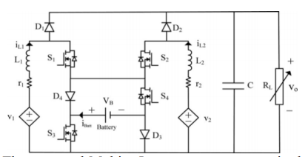
TOPOLOGY OF THE PROPOSED CONVERTER
The proposed converter Interfaces two independent power sources,v1 and v2 and a Battery as the storage element. The Input power ports are made as two current type sources by two inductors L1 and L2, in the proposed circuit which results in drawing smooth currents from the sources. The main controllable elements that control the power flow of the hybrid power system are the load resistance, RL and the switches S1 – S4. The duty ratios controlling the switches S1 – S4 are d1 – d4 respectively
The diodes D1 and D2 conduct in complementary manner with switches S1 and S2 . The diodes D3 and D4 are reverse biased by the . when S3 and S 4 are turned ON. Similarly, turning OFF of these switches results in the diodes D 3 and D4 to conduct Input currents iL1 and iL2. The dynamic behavior and steady state of the converter is observed in Continuous Current Mode (CCM)

Slide 11
MODES OR PRINCIPLE OF OPERATION
Three power operation modes of the converter can be defined based on the utilization of the battery
First Operation Mode (Existence of Sources v₁ and v₂, without Battery) : In this operation mode, the supply to the load without Battery is given by sources v₁ and v₂ which is the Basic Operation mode of the converter.
Second Operation Mode (Existence of Sources v₁ and v₂ with Battery Charging) : In this operation mode, the supply to the load while the Battery is in charging state is given by the Sources v₁ and v₂
Third Operation Mode(Existence of Sources v₁ and v₂ and Battery) : The supply to the load with the battery discharging state is given by the sources v₁ and v₂ in this operation mode

Slide 12
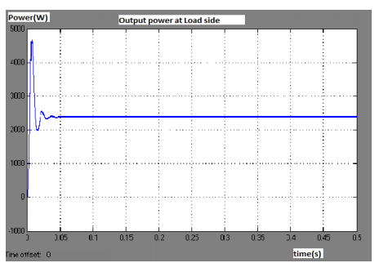
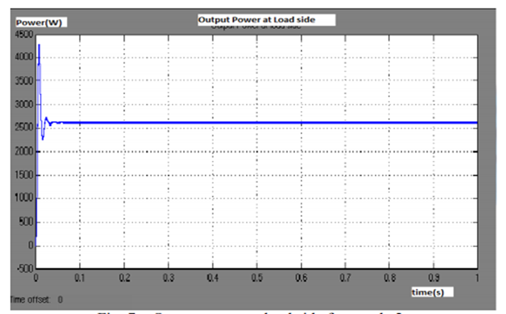
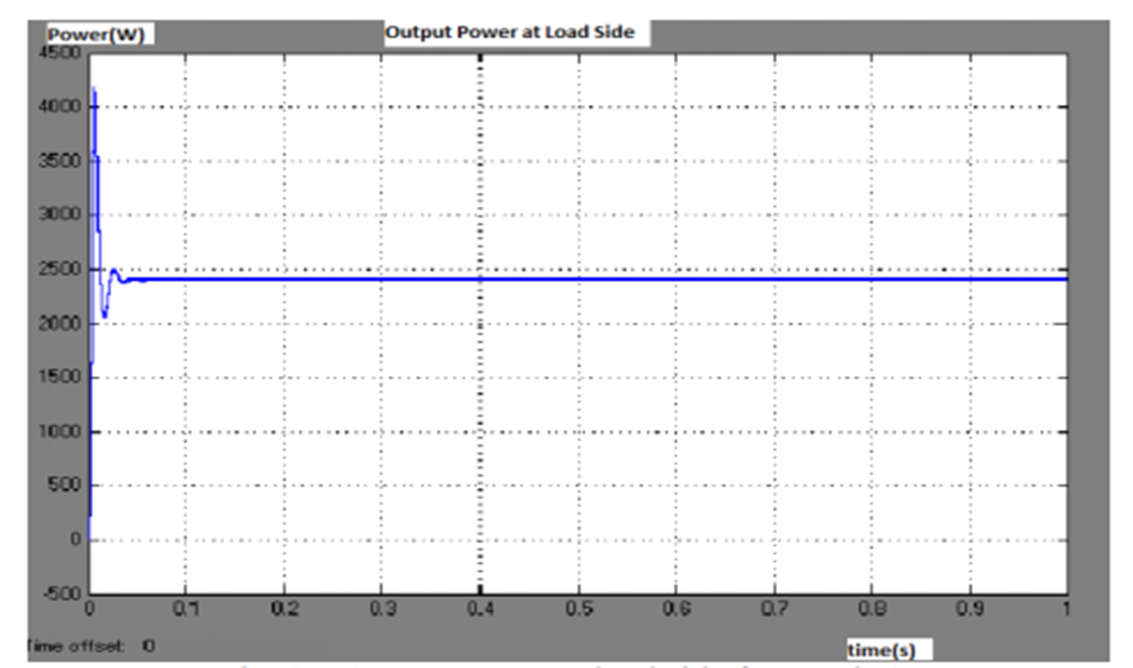
SIMULATION RESULTS
Output Power at load side for mode 1
Output Power at load side for mode 2
Output Power at load side for mode 3

Slide 13
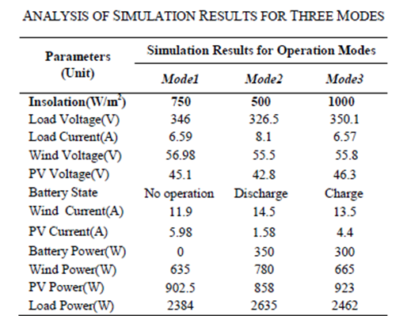
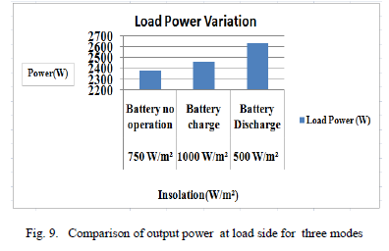
THE ANALYSIS FOR THE THREE STATES BASED ON BATTERY UTILIZATION .

Slide 14
CONCLUSION
The Analysis of the power converter along with its operational modes has been presented with results which showed that Photovoltaic- Wind hybrid system can perform well to meet the external load using energy storage mechanism.
It defines the downside of other types of hybrid power resources. Thus the system has been designed, optimized and control strategy has been considered for DC load that showed satisfactory performance.
Due to low power components and bidirectional power flow it has simple structure .In addition, the Proposed Converter can be extended to have n input ports although it has only two input ports The other advantages are
1)DC input voltages can be of different magnitudes;
2) DC sources can deliver power individually and simultaneously to load.
“The future work is to extend the system to higher ratings and solve for the synchronization issues”

Slide 15
THANK YOU

Slide 16

ANY
QUERIES ?

